Slide 1



Redis
THE FRONT PAGE OF THE INTERNET

Slide 2


History
Created in 2009 By Salvatore Sanfilippo
Designed to improve another of his products, LLOOGG
Real-time web log analyzer
Wanted to increase scalability
Written in TCL
Later switched to ANSI C
After making it open source, it quickly became popular
GitHub and Instagram began using it
Sponsored in 2013 by Pivotal Software
Sponsored by Redis Labs in 2015

Slide 3


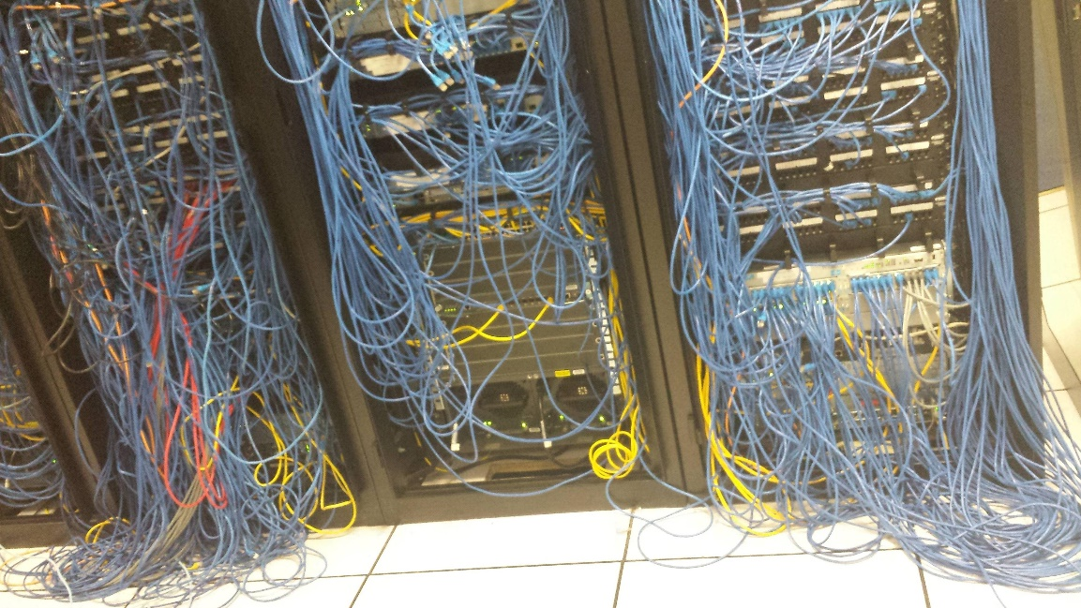
What is Redis?
Remote
Dictionary
Server

Slide 4
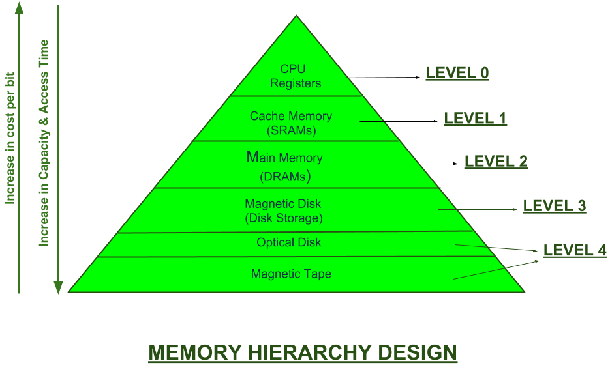
What is Redis?
In-memory data structure store
Data resides entirely in memory
Extremely fast read and write speeds
Very simple compared to disk based stores
Can handle millions of requests per second in real time applications
Data sets can’t be larger than memory

Slide 5
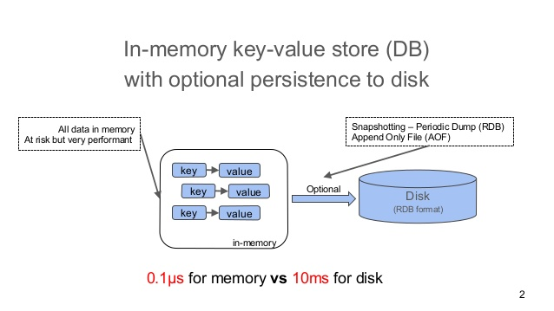
All Data in Memory?! Is that safe?!
Data Persistence
Optional but recommended
Redis Database Backup (RDB)
Snapshot of the server state at a point in time
Append Only File (AOF)
Persistent changelog file
Logs every write operation
Supports log re-writing to keep AOF size under control

Slide 6
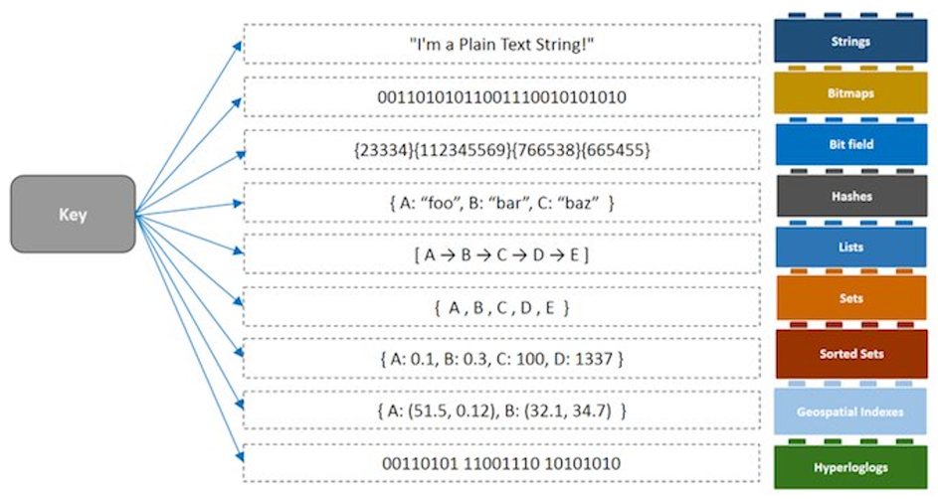
Data Types

Slide 7
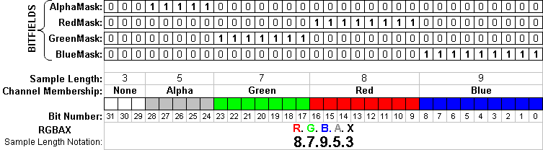
Bit Field
Store small integer values using bits instead of bytes
I.E. store “3” in two bits (11) instead of a 2 byte int
Commonly used for displaying colors

Slide 8

Hyperloglogs
Estimate the amount of unique items (cardinality) in huge datasets
Uses very little memory
Small margin of error (2%)
Estimate cardinalities larger than 10^9 with only 1.5 KB of memory
Calculating the exact cardinality of a huge dataset is impractical
Memory intensive

Slide 9

Main Competitors
Memcached
Used for caching, but not as robust as Redis
Has less metadata overhead, so it’s more efficient in simple use cases
Suited for caching smaller, static data
Multi-threaded
Easier to scale than Redis, which relies on clustering
Throw in some more CPUs instead of more machines
The better choice if you just want a cache
Great for DDoSing GitHub
1.35 Tb/s!!!

Slide 10

Main Competitors
Cassandra
Used for storing huge data
Uses Cassandra Query Language (CQL)
Easy to pick up coming from SQL
Disk based storage means slower access times
Distributed Data
Each node in a cluster holds different data, but can process any request
No single point of failure
Very scalable
Ideal for situations that require more writing than reading, like banking

Slide 11

Main Competitors
Aerospike
Used for reading and writing huge amounts of data quickly
Does nearly everything Redis does, but with a focus on scalability
Multi-threaded
Better clustering support
Memory or SSD storage
Inexpensive
Newer than Redis
Much smaller community
The coolest DB name

Slide 12
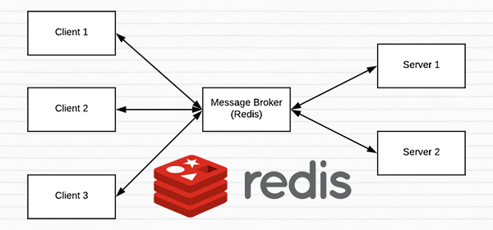
Uses for Redis
Database
Great for storing and reading huge amounts of data quickly
Ideal for data that will be updated often
Data is read from and written to memory
Caching
Spread content around for faster access
Video streaming
Message Broker
A lot like what it sounds like
Translates messages from one protocol to another
Routes messages

Slide 13

Uses for Redis
High Speed Transactions
Stock market trading
Credit card processing
Inventory
Session Management
Interactions with websites
Shopping carts, timeouts, etc
Job and Queue Management
Keep track of who on a list still needs to be emailed for time sensitive offers, etc.

Slide 14

Uses for Redis
Real-time analytics
Credit card fraud detection
Traffic monitoring
Delivery information
Track your pizza in real time!
Customized in store promotions
Individualized offers when you walk into a store
Search Engine

Slide 15
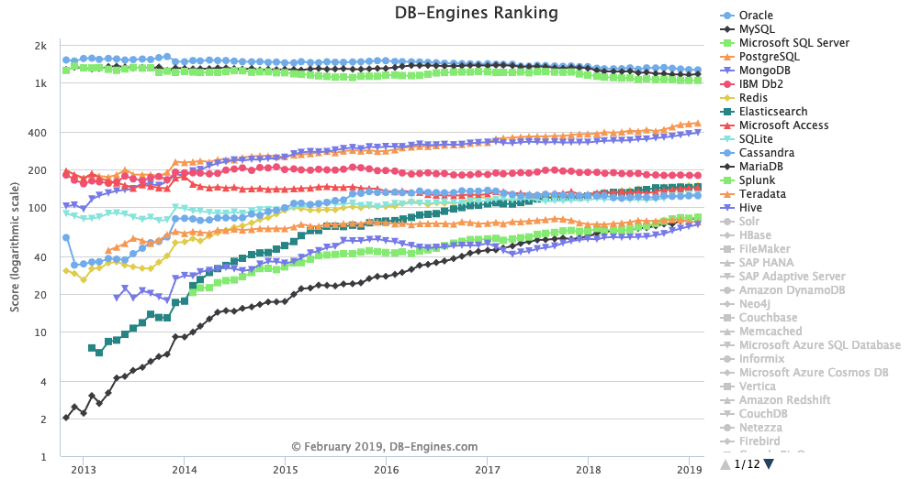
Uses for Redis
Time-Series Data

Slide 16

Uses for Redis
Machine Learning
Fast Data Ingest
Exactly what it sounds like, but more complicated than it sounds
Data bursts
Multiple formats
Data that needs to be filtered
Geospatial Indexing

Slide 17
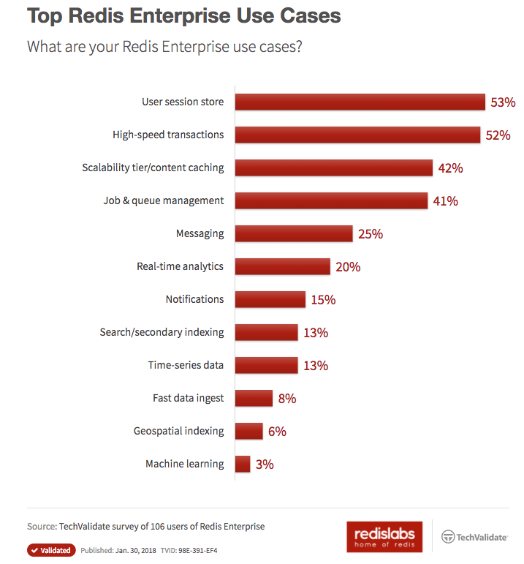
Uses for Redis

Slide 18
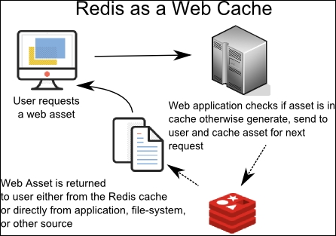
How Redis Works as a Cache
Least Recently Used (LRU) Eviction
If memory limit is reached and new data is added to the set, the data that hasn’t been accessed for the longest amount of time is evicted
Not a true LRU implementation
Samples an adjustable number of keys and evicts the one with the oldest access time
Maxmemory directive sets an amount of memory to be used for a data set
Important since the data set must fit in memory!

Slide 19
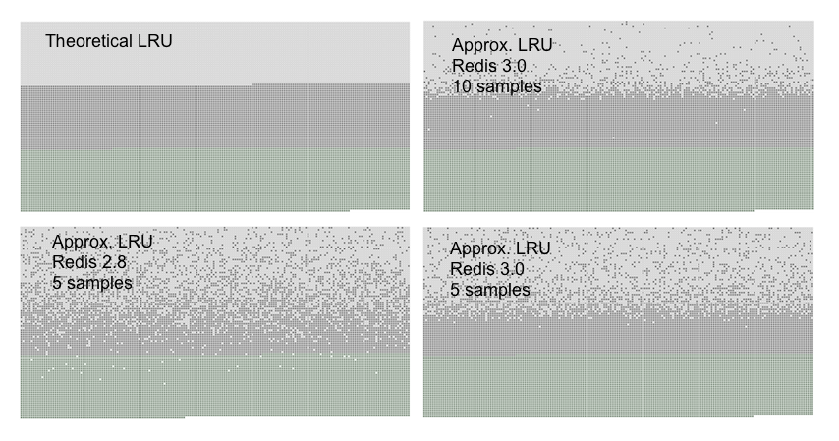
How Redis Works as a Cache
Keys accessed from first to last
Light gray – evicted
Dark gray – not evicted
Green – added objects

Slide 20

How Redis Works as a Cache
Other eviction polices:
noeviction – Returns an error when memory limit is reached
allkeys-lru - evict least recently used key
volatile-lru – evict only LRU keys that are set to expire
allkeys-random – evict keys at random
volatile-random – randomly evict keys that are set to expire
volatile-ttl – evict keys with a shorter time to live (TTL) first

Slide 21
How Redis Works as a Cache
Least Frequently Used (LFU) Eviction
New in Redis 4.0
Evict keys based on how often they’re used
Recently loaded keys will be evicted if they aren’t frequently accessed
Prevents you from evicting a key that’s used often because a rarely used key was accessed recently.

Slide 22
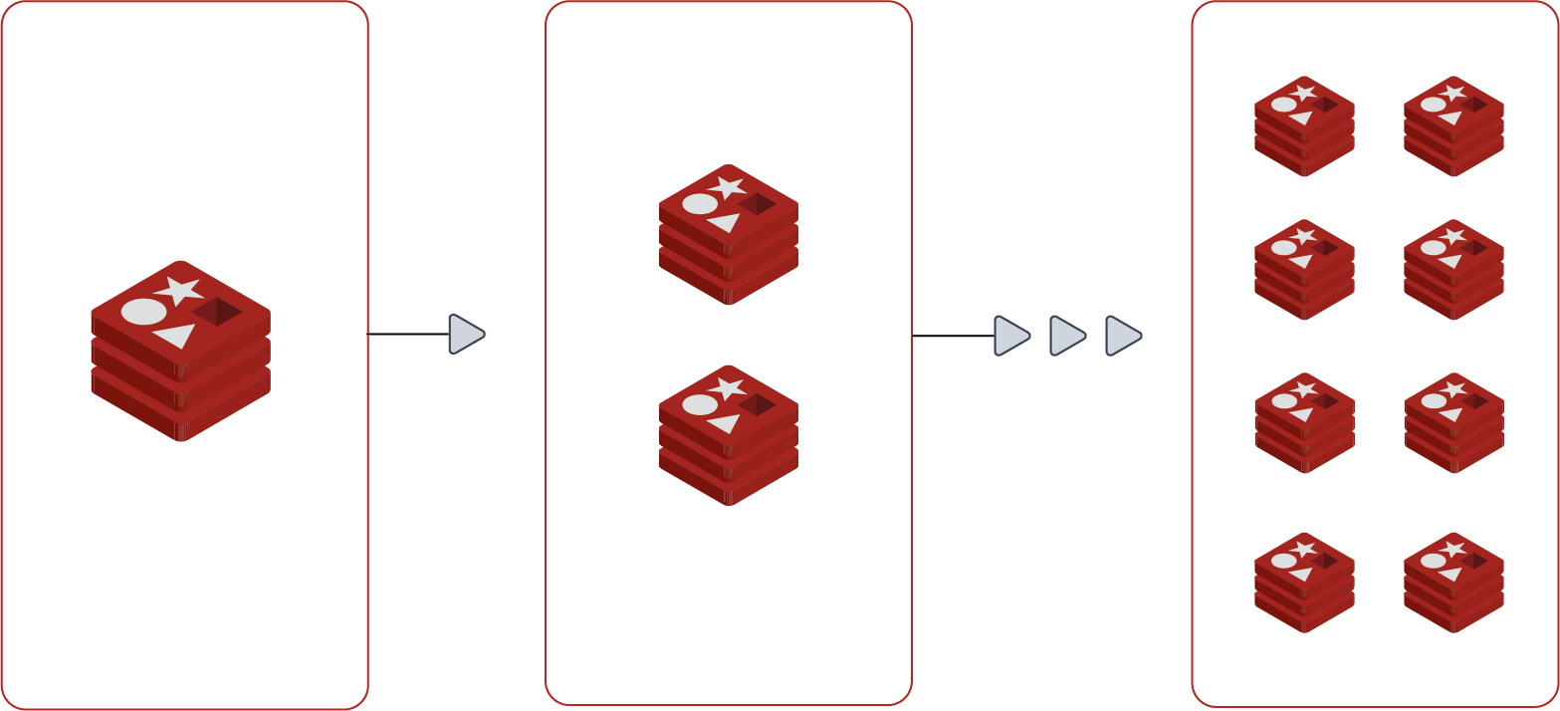
Scalability
2 main methods
Replication (mirroring)
Copy all data to another instance
Good for ensuring data is available
Sharding (partitioning)
Splits up data among instances
Good for performance

Slide 23
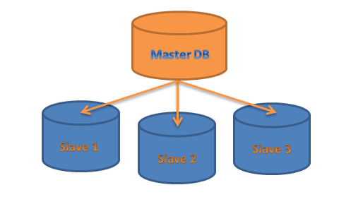
Replication
Any Redis instance can be slaved to be an exact copy of a master instance
Slaves can be masters to other slaves
Uses asynchronous replication by default
Much faster than synchronous
No need to wait for slaves to sync before writing again
Writes data to the master and copies it to the slave
Low latency when writing data
Uses less bandwidth
Less risk of failure
Store updates persistently, then distribute them

Slide 24
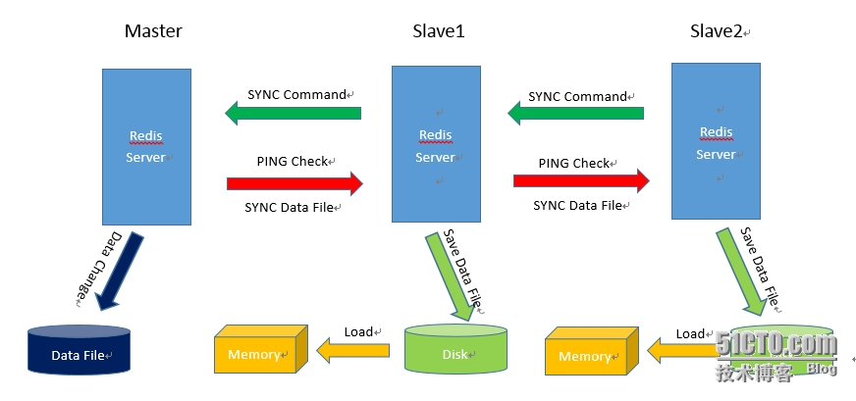
Replication Chart

Slide 25
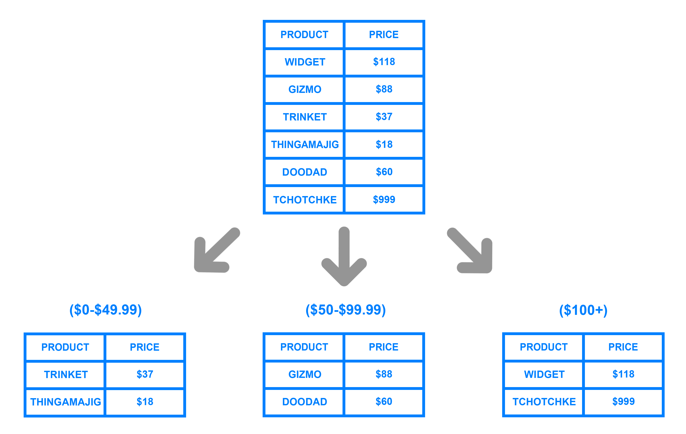
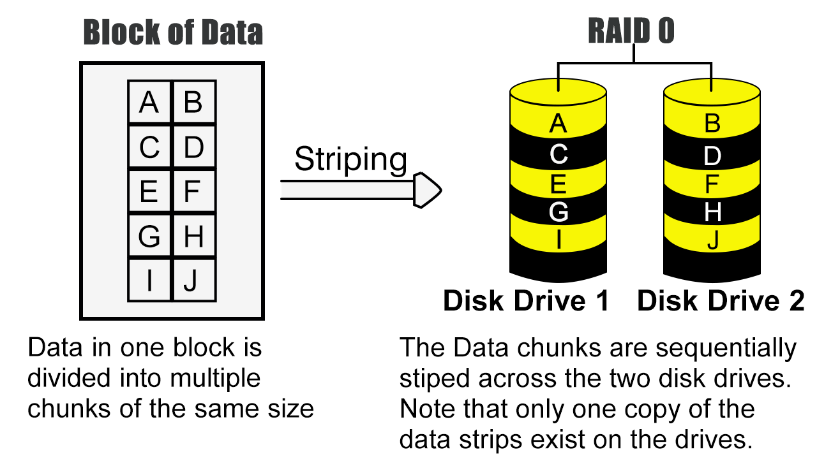
Sharding
Splits up data across multiple Redis instances
Each instance only holds part
EXAMPLE
Even IDs go to one instance
Odds go to another
Allows for larger databases (no memory limitations)
Spread the workload
Multiple CPUs
More bandwidth
Like RAID 0

Slide 26

Lua Scripting
An extension programming language written in clean C
Works embedded in a host client's code
The host program can call functions that invoke the execution of Lua code

Slide 27

Lua Scripting Benefits
Can call C functions without having to learn C
Easier to avoid writing code that results in undefined behavior
Dynamic, requiring no additional compilation and linking if code is changed
Garbage collected
Small footprint (several hundred kilobytes)

Slide 28
RESP - Redis Serialization Protocol
Used for mass insertion of data
Fairly simple to implement
Extremely fast to parse
Somewhat human readable
Binary safe
Uses prefixed lengths for transferring bulk data

Slide 29
RESP - Redis Serialization Protocol
Specify length of array
Length of commands and data must be specified
A \r\n follows every piece of information
Example:
SET user Broday
*3\r\n$4\r\nuser\r\n$6\r\nBroday\r\n

Slide 30
Redis Cluster for Automatic Partitioning
Allows data to be sharded across multiple Redis Nodes
Separates large databases into smaller faster parts
Can split data sets among multiple nodes
scales computational power and available memory
Allows for continued operation when a subset of nodes are experience a failure
Can be used with Docker

Slide 31

Redis Sentinel for availability
Only 90s kids will get this
Provides high-availability
Robust
Monitors redis instances to ensure data integrity
Rapid notification of failures
Automatic failover
yeet the weakling
promotes a replica redis instance to master and adjusts other replicas accordingly to accept their new master as supreme leader
Sentinel reports the new address of the new master
Distributed Sentinel monitoring will cause failover when several Sentinel processes agree that a master has failed
reduces false positives

Slide 32

Redis Sentinel Cons
Redis recommends 3 instances of Sentinel for a robust deployment
Must design Redis Sentinel topology in such a way that failures are independent
For example, run each instance on different physical servers
Docker and Sentinel do not play well together
Docker's port remapping breaks Sentinel's automatic discovery of other Sentinel processes
Also breaks the list of replicas for a master

